Slide 2
METHOD OVERLOADING
Method overloading is a feature in C++ that allows creation of several methods with the same name but with different parameters.
For example, print(), print(int), and print("Hello") are overloaded methods.
While calling print() , no arguments are passed to the function
When calling print(int) and print("Hello") , an integer and a string arguments are passed to the called function.
Allows one function to perform different tasks

Slide 3
METHOD OVERLOADING
Basically, there are two types of polymorphism:
Compile time (or static) polymorphism
Run-time (or dynamic) polymorphism.
Static polymorphism -> Method overloading - calls a function using the best match technique or overload resolution.
© Oxford University Press 2015. All rights reserved.

Slide 4

MATCHING FUNCTION CALLS WITH OVERLOADED METHODS
When an overloaded function is called, one of the following cases occurs:
Case 1: A direct match is found, and there is no confusion in calling the appropriate overloaded function.
Case 2: If a match is not found, a linker error will be generated. However, if a direct match is not found, then, at first, the compiler will try to find a match through the type conversion or type casting.
Case 3: If an ambiguous match is found, that is, when the arguments match more than one overloaded function, a compiler error will be generated. This usually happens because all standard conversions are treated equal.

Slide 5
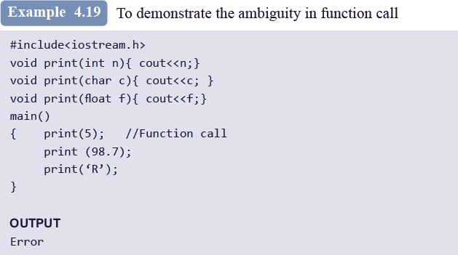

Slide 6
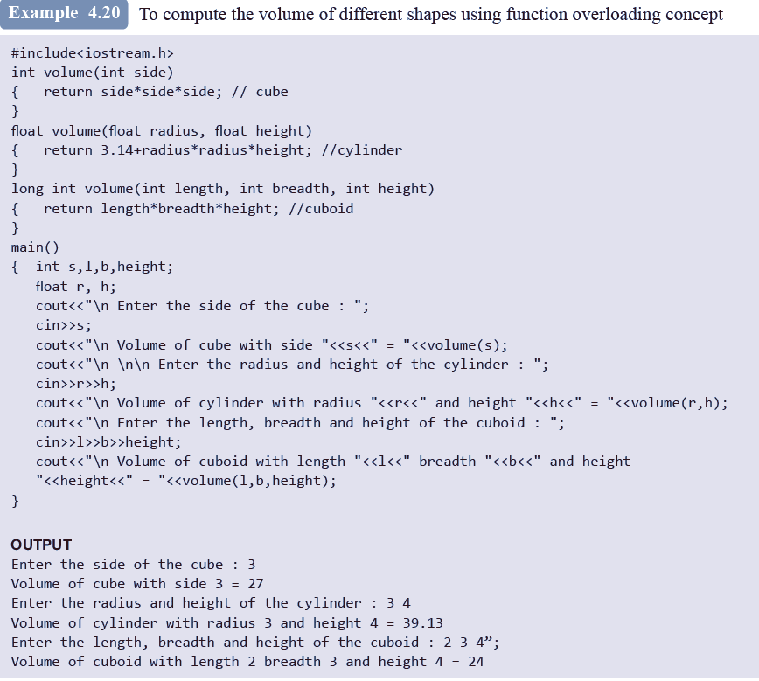

Slide 7
Methods that Cannot be Overloaded
Methods that differ only in the return type
Parameter declarations that differ only in a pointer * versus an array []
If paramters differ only in the prescence or absence of const and/or volatile
Using typedef does not introduce a new type, hence cannot be overloaded
Methods that differ only in their default arguments
Methods that differ only in a reference parameter and a normal parameter

Slide 8
Method overloading- Points to Remember
There are multiple definitions for the same function name in the same scope
The definitions of these functions vary according to the types and/or the number of arguments in the argument list
Data type of the return value is not considered while writing overloaded functions because the appropriate function is called at the compile time while the return value will be obtained only when the function is called and executed

